Slide 1
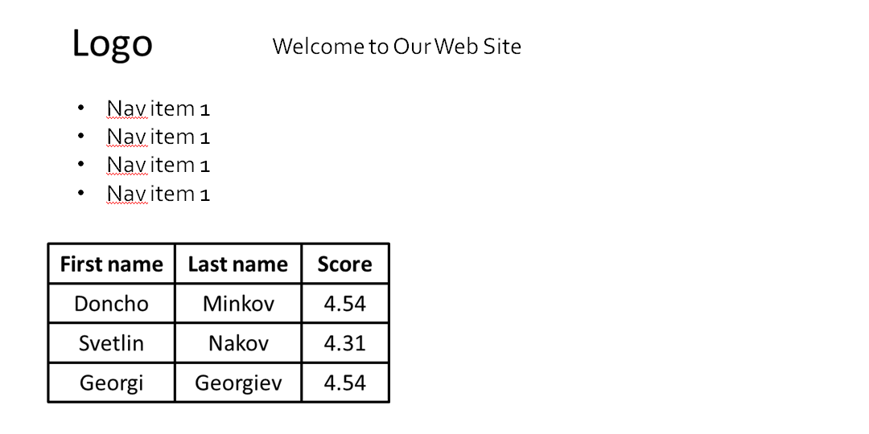
Refactor the refactoring-homework.html web page and make its HTML semantic
Create a web page using semantic HTML by the design below
Create a web page using semantic HTML by the design below

Slide 2
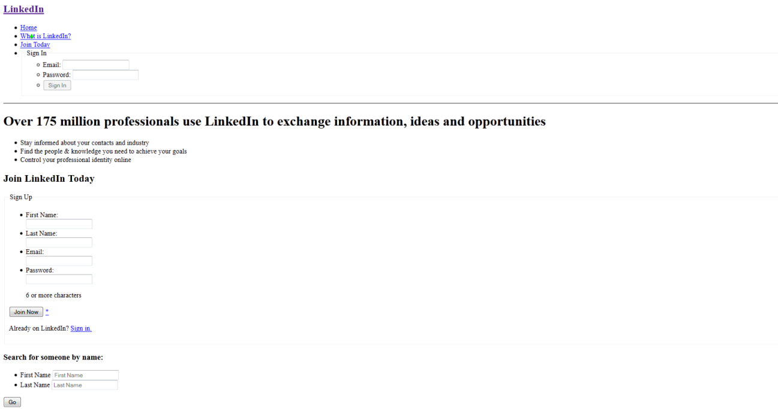
*Note: do not try to make the same styles in Exercise 2 and Exercise 3. Implement just the content with its semantics
Use some kind of approach to support old (non-HTML5-compatible) Web browsers like IE6-IE8

